Slide 1
Machine Learning
Department of CSE
Chaithanya Bharathi Institute Of Engineering Technology(A)
Gandipet Hyderabad 500075
Sources /References : Giuseppe Bonaccorso, Machine Learning Algorithms, 2017, Packt Publishing.

Slide 2
Unit –II Linear Classification 3rd Part

Slide 3
Philosophical Principle: Occam's razor
It states that the first choice must always be the simplest and only if it doesn't fit, it's necessary to move on to more complex models.

Slide 4
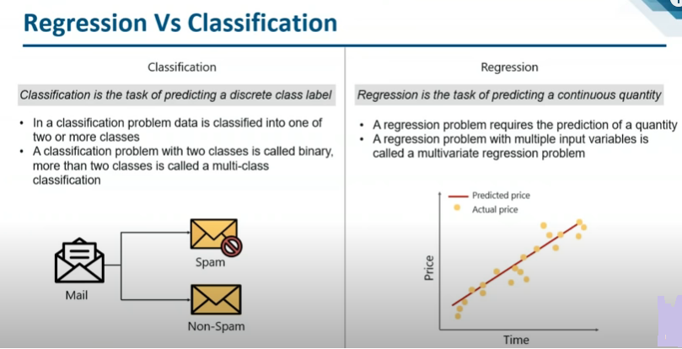

Slide 5
Definition
Logistic Regression is a method used to predict a dependent variable (Y), given an independent variable (X), such that the dependent variable is categorical.
Linear Regression is a method used to predict a dependent variable (Y), based on values of independent variable (X).It can be used for the cases where we want to predict some continuous quantity.

Slide 6
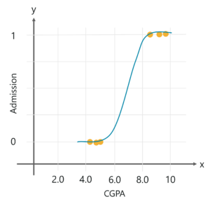
Why And When Do We Use Logistic Regression

Slide 7
Types of logistic regression
Binary (Pass/Fail)
Multinomial (Cats, Dogs, Sheep)
Ordinal (Low, Medium, High)

Slide 8
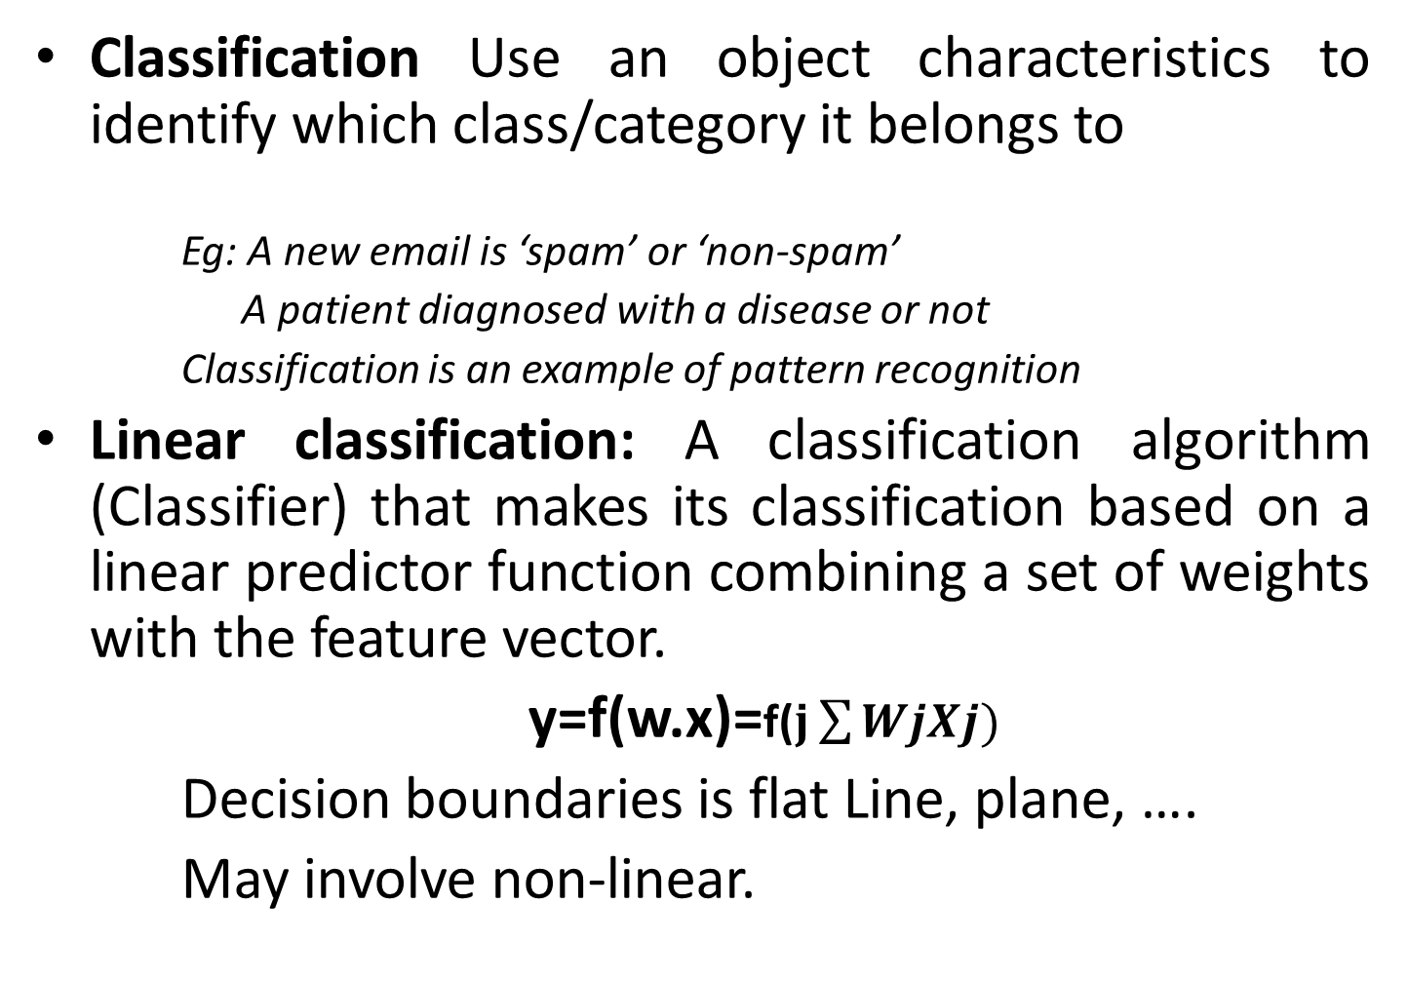
Classification Use an object characteristics to identify which class/category it belongs to
Eg: A new email is ‘spam’ or ‘non-spam’
A patient diagnosed with a disease or not
Classification is an example of pattern recognition
Linear classification: A classification algorithm (Classifier) that makes its classification based on a linear predictor function combining a set of weights with the feature vector.
y=f(w.x)=f($j\sum{WjXj)}$
Decision boundaries is flat Line, plane, ….
May involve non-linear.

Slide 9
Explicitly creating the discriminant function (Discriminant function)
Perceptron
Support vector machine
Probabilistic approach
Model the posterior distribution
Algorithms : Logistic regression

Slide 10
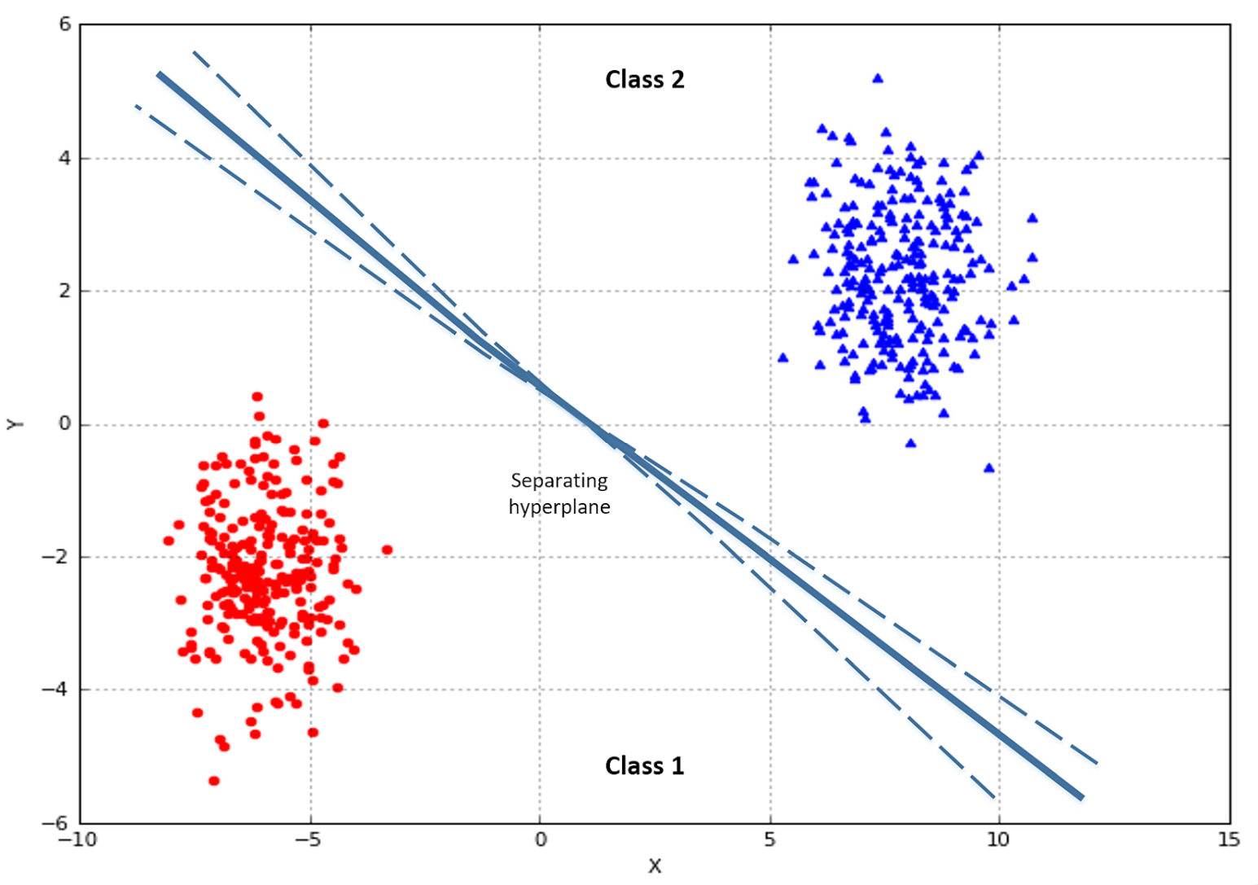
Linear Classification

Slide 11
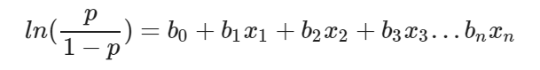
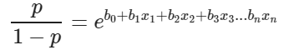
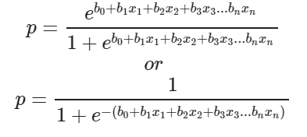
Maths…..

Slide 12
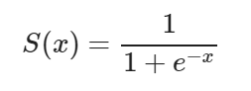
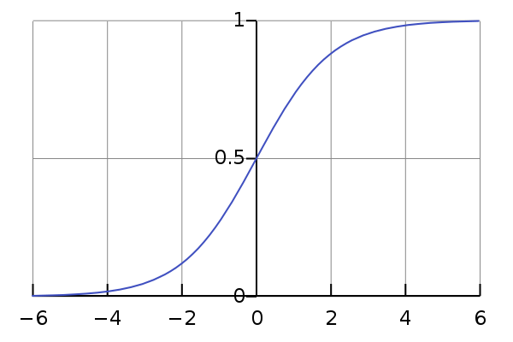
Sigmoid function

Slide 13
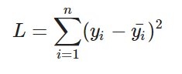
Loss Function

Slide 14
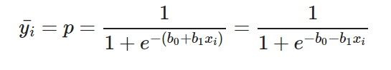
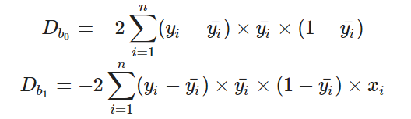
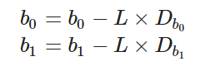
Gradient Descent Approach
Initially let b0=0 and b1=0. Let L be the learning rate.
Calculate the partial derivative with respect to b0 and b1.
3. Next we update the values of b0 and b1:
4. We repeat this process until our loss function is a very small

Slide 15
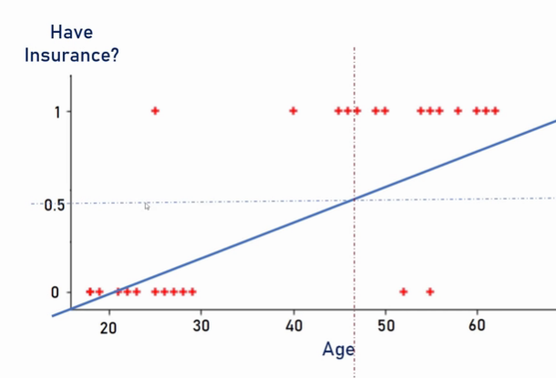

Slide 16
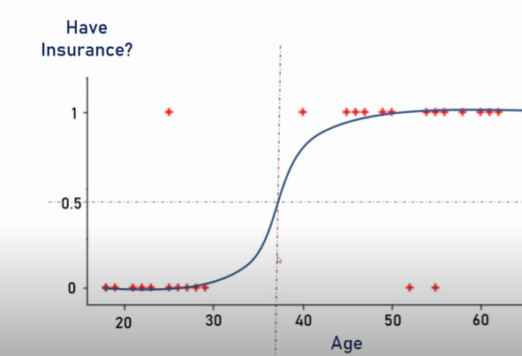

Slide 17
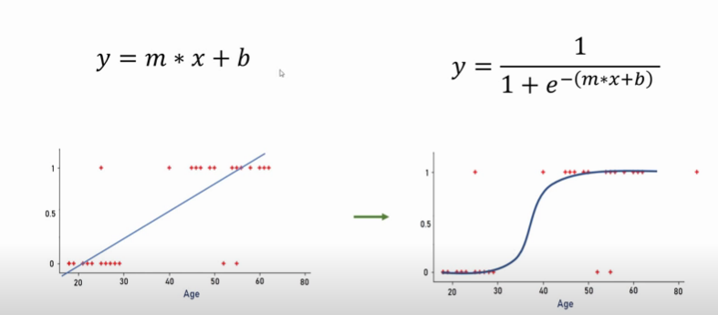

Slide 18
we have the following dataset made up of n m-dimensional samples:
This dataset is associated with the following target set:
Generally, there are two equivalent options; binary and bipolar outputs and different algorithms are based on the former or the latter without any substantial difference. Normally, the choice is made to simplify the computation and has no impact on the results.

Slide 19
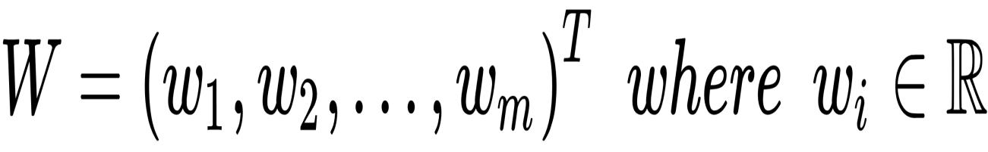
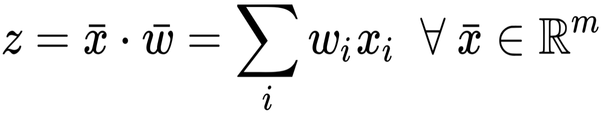
We can now define a weight vector made of m continuous components:
We can also define the quantity, z:
If x is a variable, z is the value determined by the hyperplane equation. Therefore, in a bipolar scenario, if the set of coefficients w that has been determined is correct, the following happens:

Slide 20
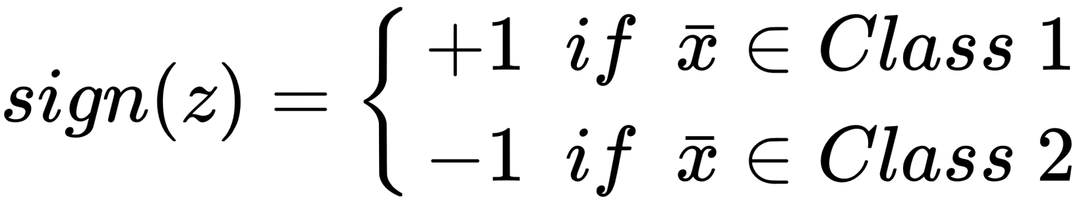
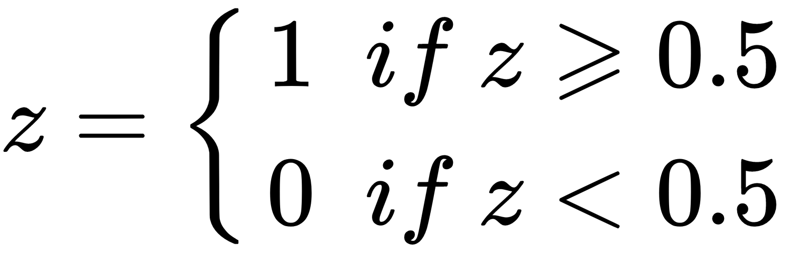
When working with binary outputs, the decision is normally made according to a threshold. Eg: if the output z ∈ (0, 1), the previous condition becomes the following:
Now, we need to optimize w to reduce the classification error. If such a combination exists (with a certain error threshold), we say that our problem is linearly separable. On the other hand, when it's impossible to find a linear classifier, the problem is defined as non-linearly separable.

Slide 21
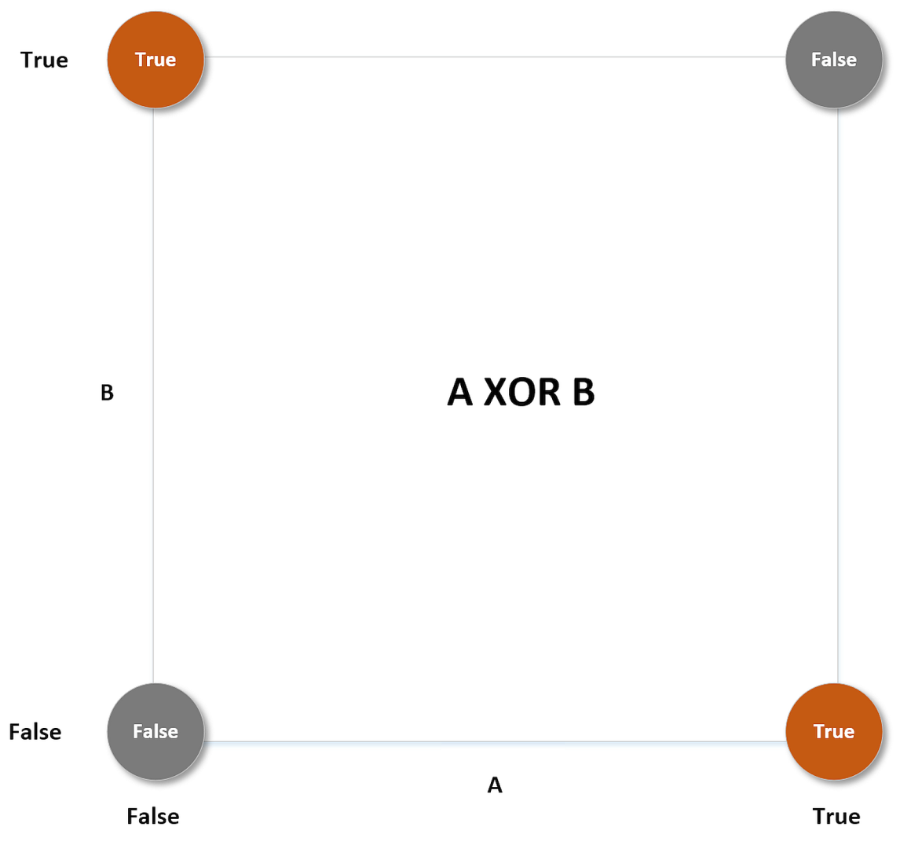

Slide 22
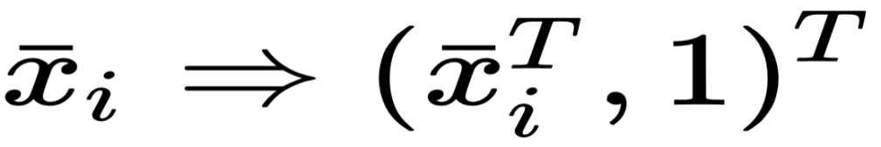
Logistic Regression
It is based on the probability of a sample belonging to a class.
As our probabilities must be continuous in ℜ and bounded between (0, 1), it's necessary to introduce a threshold function to filter the term z.
As already done with linear regression, we can get rid of the extra parameter corresponding to the intercept by adding a 1 element at the end of each input vector:

Slide 23
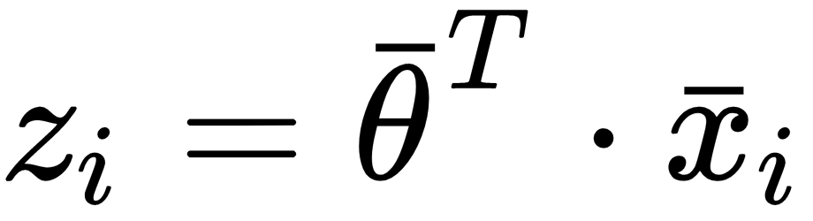
In this way, we can consider a single parameter vector θ, containing m + 1 elements, and compute the z-value with a dot product:
Probability p(xi) that an element belongs to class 1. Clearly, the same element belongs to class 0 with a probability 1 - p(xi).

Slide 24
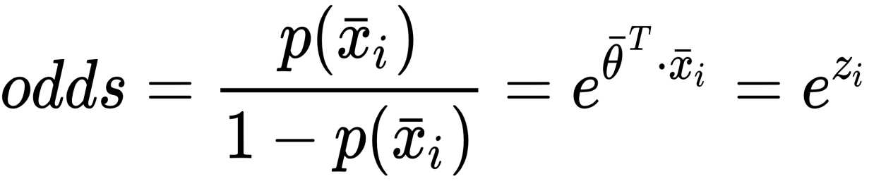
Logistic regression is mainly based on the idea of modeling the odds of belonging to class 1 using an exponential function:
This function is continuous and differentiable on ℜ, always positive, and tends to infinite when the argument x → ∞. These conditions are necessary to correctly represent the odds, because when p → 0, odds → 0, but when p → 1, odds → ∞.

Slide 25
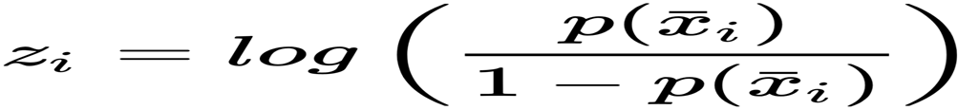
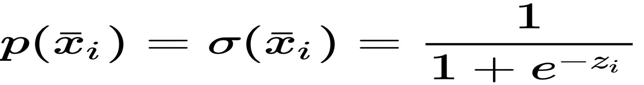
If we take the logit (which is the natural logarithm of the odds), we obtain an expression for the structure of z_{i}:
A function with a support on ℜ, bounded between 0 and 1, and which satisfies the previous expression is the sigmoid (or logistic) function:

Slide 26
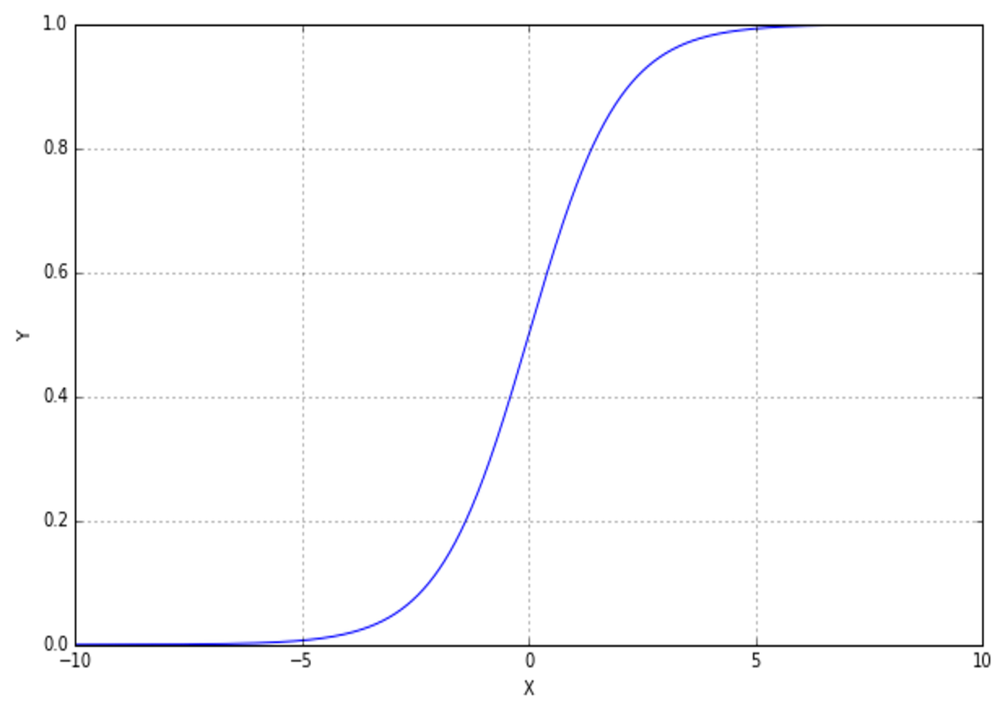
Plot of the sigmoid function; σ(x) → 0 when x → -∞ and σ(x) → 1 when x → ∞

Slide 27
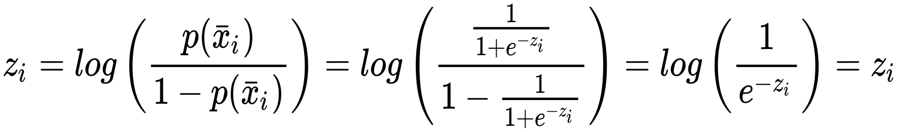
Probability distribution using a sigmoid, we obtain the following:
So, we can define the probability of a sample belonging to a class (from now on, we'll call them 0 and 1) as follows:

Slide 28
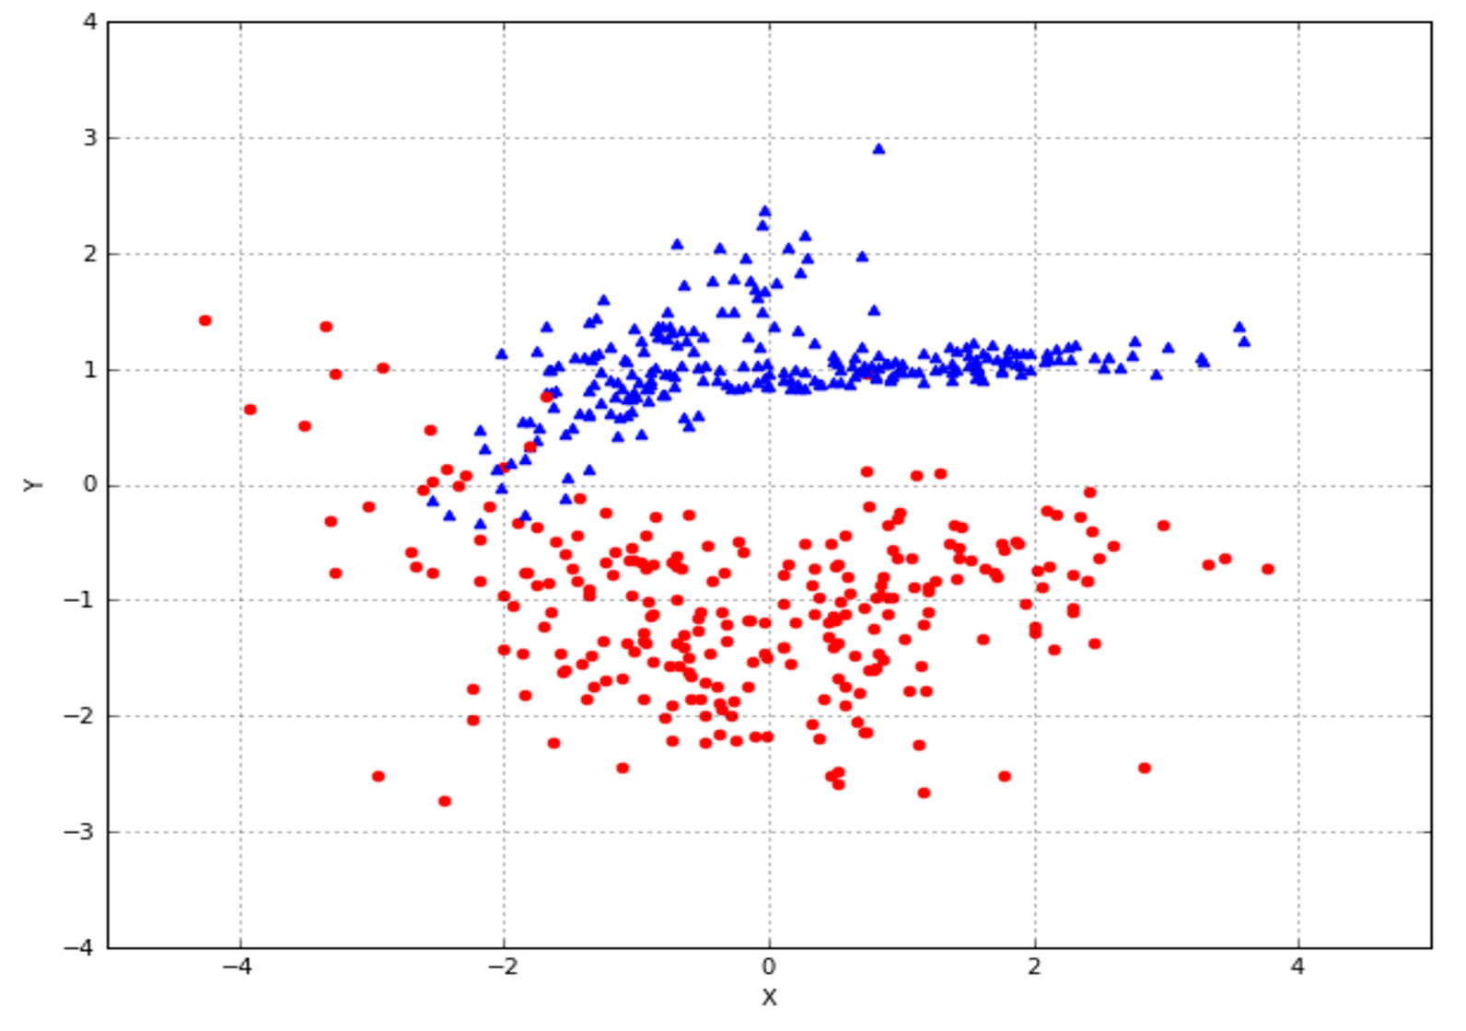
Implementations
Let's consider a toy dataset made of 500 samples:
The dots belong to class 0,
while the triangles belong to class 1.

Slide 29
Step1: To split the dataset into training and test sets:
from sklearn.model_selection import train_test_split X_train, X_test, Y_train, Y_test = train_test_split(X, Y, test_size=0.25)
Now, we can train the model using these default parameters:
from sklearn.linear_model import LogisticRegression lr = LogisticRegression() lr.fit(X_train, Y_train) LogisticRegression(C=1.0, class_weight=None, dual=False, fit_intercept=True, intercept_scaling=1, max_iter=100, multi_class='ovr', n_jobs=1, penalty='l2', random_state=None, solver='liblinear', tol=0.0001, verbose=0, warm_start=False)
print(lr.score(X_test, Y_test)) 0.95199999999999996

Slide 30
It's also possible to check the quality through a cross-validation (like for linear regression):
from sklearn.model_selection import cross_val_score print(cross_val_score(lr, X, Y, scoring='accuracy', cv=10)) array([ 0.96078431, 0.92156863, 0.96 , 0.9 8 , 0.96 , 0.98 , 0.96 , 0.96 , 0.91836735, 0.97959184])
Resulting hyperplane parameters:
print(lr.intercept_) -0.64154943 print(lr.coef_) [ 0.34417875, 3.89362924]

Slide 31
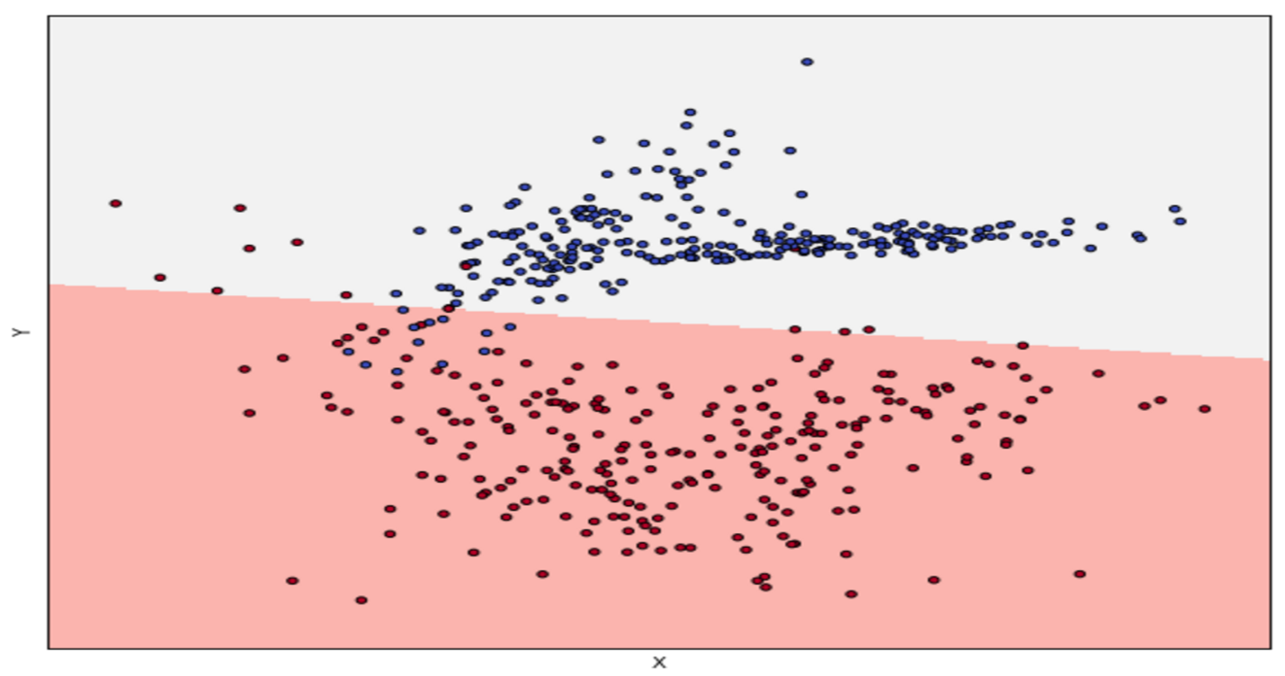
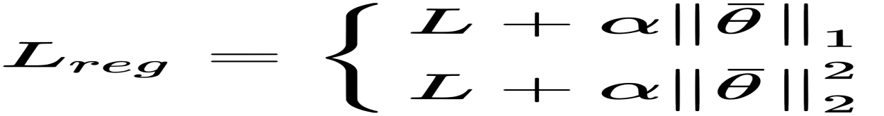
Just like for linear regression, it's possible to impose norm conditions on the weights. In particular, the actual function becomes this:

Slide 32
Classification Metrics
Confusion Matrix...
Accuracy...
Precision: ...
Recall or Sensitivity: ...
Specificity: ...
F1 Score:
Kappa
ROC,AUC

Slide 33
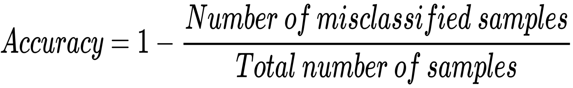
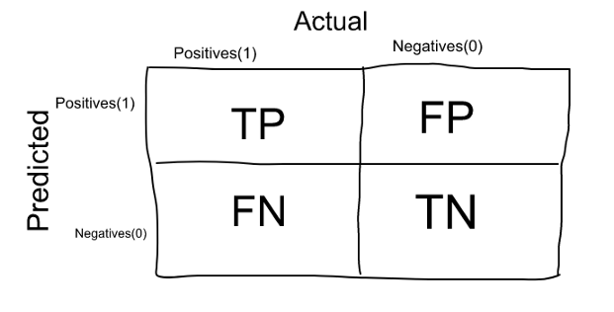
Classification metrics
Confusion Matrix:
The Confusion matrix is one of the most intuitive and easiest metrics used for finding the correctness and accuracy of the model.
It is used for Classification problem where the output can be of two or more types of classes.

Slide 34
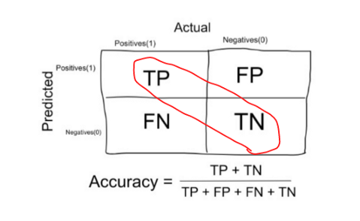
When to minimize and What to Minimize
Minimizing False Negatives
Minimizing False Positives

Slide 35
When to use Accuracy:
Accuracy is a good measure when the target variable classes in the data are nearly balanced.
Ex:60% classes in our fruits images data are apple and 40% are oranges.
When NOT to use Accuracy:
Accuracy should NEVER be used as a measure when the target variable classes in the data are a majority of one class.

Slide 36
Eg: In our cancer detection example with 100 people, only 5 people has cancer. Let’s say our model is very bad and predicts every case as No Cancer. In doing so, it has classified those 95 non-cancer patients correctly and 5 cancerous patients as Non-cancerous. Now even though the model is terrible at predicting cancer, The accuracy of such a bad model is also 95%.

Slide 37
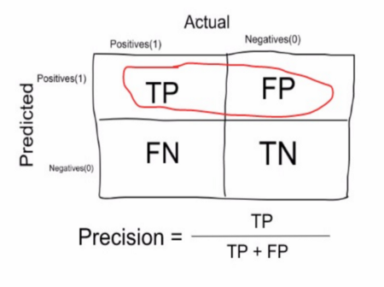
Precision:
Precision is a measure that tells us what proportion of patients that we diagnosed as having cancer, actually had cancer. The predicted positives (People predicted as cancerous are TP and FP) and the people actually having a cancer are TP.

Slide 38
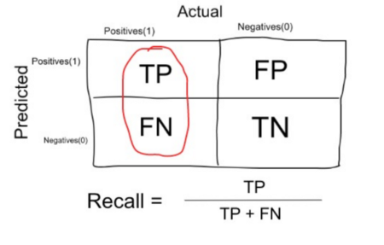
Recall or Sensitivity:
Recall is a measure that tells us what proportion of patients that actually had cancer was diagnosed by the algorithm as having cancer

Slide 39
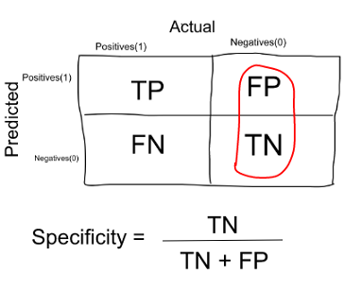
Specificity:
Specificity is a measure that tells us what proportion of patients that did NOT have cancer, were predicted by the model as non-cancerous.

Slide 40
True positive (TP): A positive sample correctly classified.
False positive (FP): A negative sample classified as positive. In statistical terms, this is called a type I error because the hypothesis that is checked (in this case, the negativity) is true, but it's rejected.
In many scenarios, it represents a false alert that can always be canceled without particular implications.

Slide 41
True negative (TN): A negative sample correctly classified.
False negative (FN): A positive sample classified as negative. Contrary to the case of FP, this is called a type II error, because the hypothesis that is checked (negativity) is false, but it's not correctly rejected
Clearly, P = TP + FN, while N = TN + FP.

Slide 42
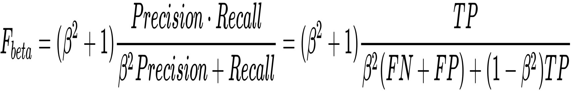
F-Beta
A weighted harmonic mean between precision and recall is provided as follows:
A beta value equal to 1 determines the so-called F₁ score, which is a perfect balance between the two measures. A beta less than 1 gives more importance to precision and a value greater than 1 gives more importance to recall.

Slide 43
from sklearn.metrics import fbeta_score
rint(fbeta_score(Y_test, lr.predict(X_test), beta=1)) 0.968 print(fbeta_score(Y_test, lr.predict(X_test), beta=0.75)) 0.964 print(fbeta_score(Y_test, lr.predict(X_test), beta=1.25)) 0.972
The highest score is achieved by giving more importance to precision (which is higher), while the least one corresponds to a recall predominance

Slide 44
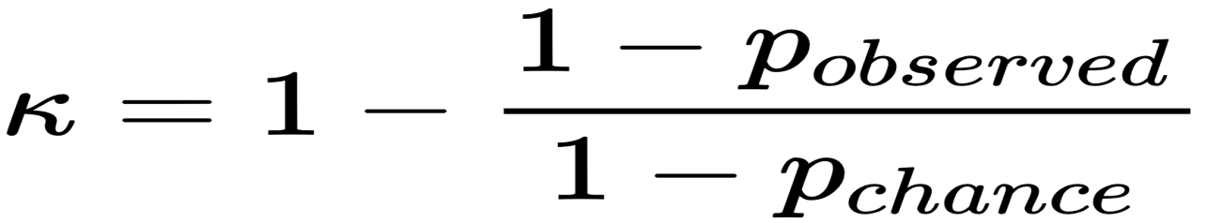
Cohen's Kappa
This metric is different because its goal is to measure the agreement between two raters (for example, ground truth, human labeling, and estimators)
considering the possibility that the raters agree without full awareness (in general, by chance). It is computed as follows

Slide 45
The two values represent, respectively, the observed agreement between the raters and the probability of a chance agreement.
Coefficient κ is bounded between 0 (no agreement) and 1 (total agreement). In fact, if p_{observed} = 1 and p_{chance} = 0, κ = 1, while p_{observed} = 0 and p_{chance} = 0,
k = 0.
from sklearn.metrics import cohen_kappa_score print(cohen_kappa_score(Y_test, lr.predict(X_test))) 0.936

Slide 46
Learning Curve
In many tasks, it's helpful to check how the number of samples impacts training performance. This can be achieved by plotting a learning curve, which is normally based on both training and validation scores (preferably CV score).

Slide 47
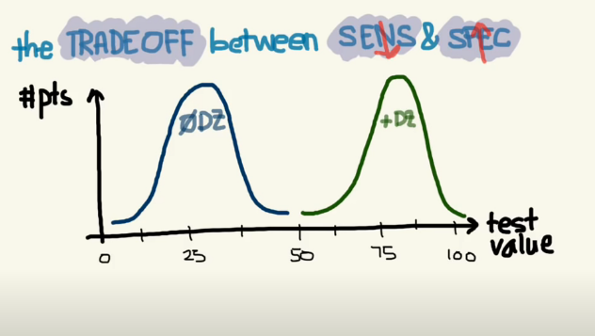
Trade off between sensitivity and specificity

Slide 48
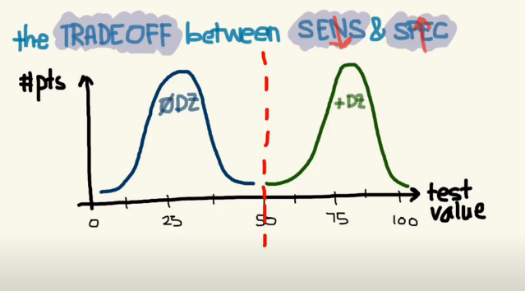

Slide 49
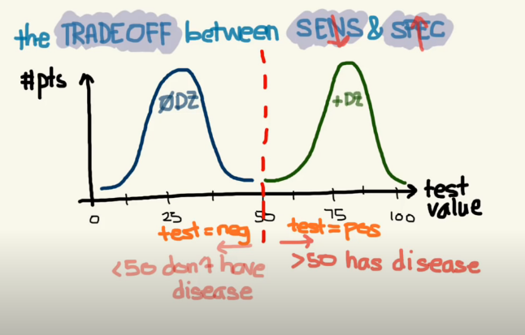

Slide 50
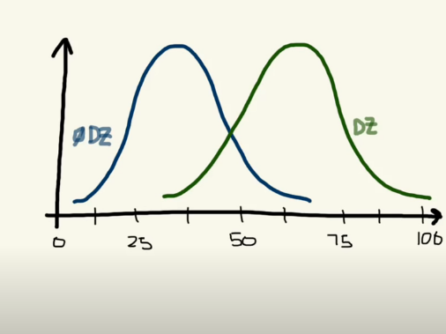

Slide 51
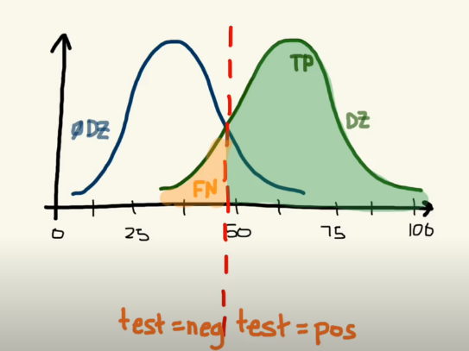

Slide 52
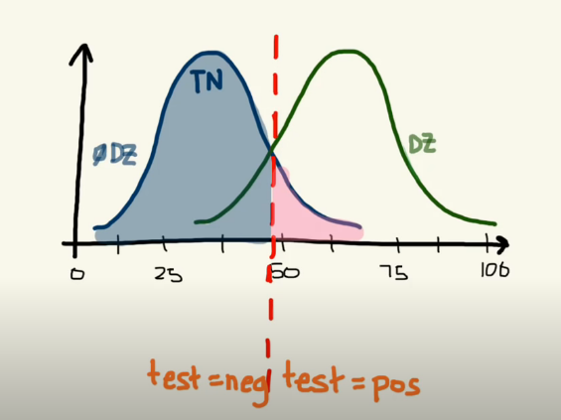

Slide 53
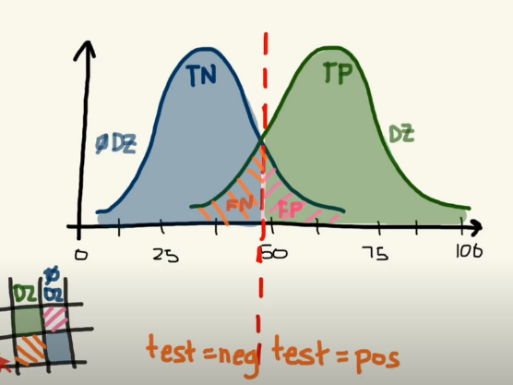

Slide 54
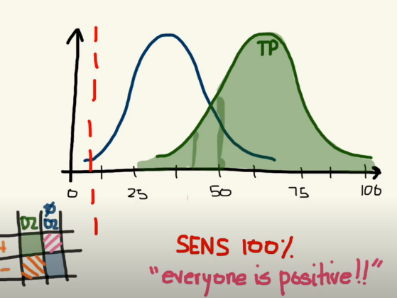

Slide 55
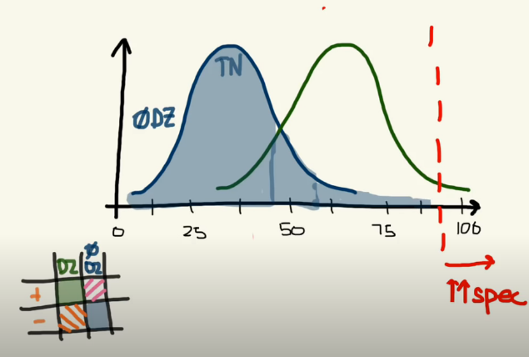

Slide 56
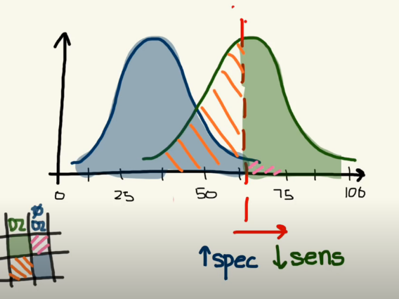

Slide 57
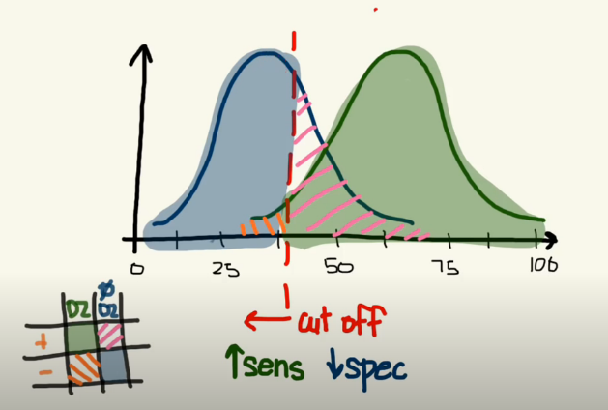

Slide 58


Slide 59


Slide 60


Slide 61
Roc Curve
The ROC curve is a valuable tool to compare different classifiers that can assign a score to their predictions. In general, this score can be interpreted as a probability, so it's bounded between 0 and 1.
The plane is structured as shown in the following diagram:

Slide 62


Slide 63


The x-axis represents the increasing false positive rate (1 - FPR) also known as 1 - Specificity, defined
The y-axis represents the true positive rate (TPR) also known as Sensitivity: as follows:

Slide 64
from sklearn.metrics import roc_curve fpr, tpr, thresholds = roc_curve(Y_test, Y_scores)
The output is made up of increasing true and false positive rates and decreasing thresholds (which aren't normally used for plotting the curve).
Before proceeding, it's also useful to compute the Area Under the Curve (AUC), whose value is bounded between 0 (worst performance) and 1 (best performance), with a perfectly random value corresponding to 0.5 (which is the area of one of the two right triangles):

Slide 65
from sklearn.metrics import auc print(auc(fpr,tpr)) 0.97
We already know that our performance is rather good because the AUC is close to 1, so FPR << TPR. Now we can plot the ROC curve using matplotlib.

Slide 66
import matplotlib.pyplot as plt plt.figure(figsize=(8, 8))
plt.plot(fpr, tpr, color='red', label='Logistic regression (AUC: %.2f)' % auc(fpr, tpr)) plt.plot([0, 1], [0, 1], color='blue', linestyle='--') plt.xlim([0.0, 1.0]) plt.ylim([0.0, 1.01]) plt.title('ROC Curve') plt.xlabel('False Positive Rate') plt.ylabel('True Positive Rate') plt.legend(loc="lower right") plt.show(

Slide 67


Slide 68
Titanic dataset
The training-set has 891 examples and 11 features + the target variable (survived). 2 of the features are floats, 5 are integers and 5 are objects. Below I have listed the features with a short description:
survival: Survival
PassengerId: Unique Id of a passenger.
pclass: Ticket class
sex: Sex
Age: Age in years
sibsp: # of siblings / spouses aboard the Titanic
parch: # of parents / children aboard the Titanic
ticket: Ticket number
fare: Passenger fare
cabin: Cabin number
embarked: Port of Embarkation
train_df.describe()

